Slide 1
Car Window Control
By: Misael Conception and Robert Harmison

Slide 2
Final Project for Intro to Microprocessors
MSP430 Micro Controller
Hardware
Software
Implementation
Conculsion

Slide 3
MSP430 Micro Controller
16MHz CPU
16 Bit register’s
16 KB flash RAM
2 port’s with 8 I/O interfaces
System Clock
Two Timers
One Watch Dog Timer

Slide 4
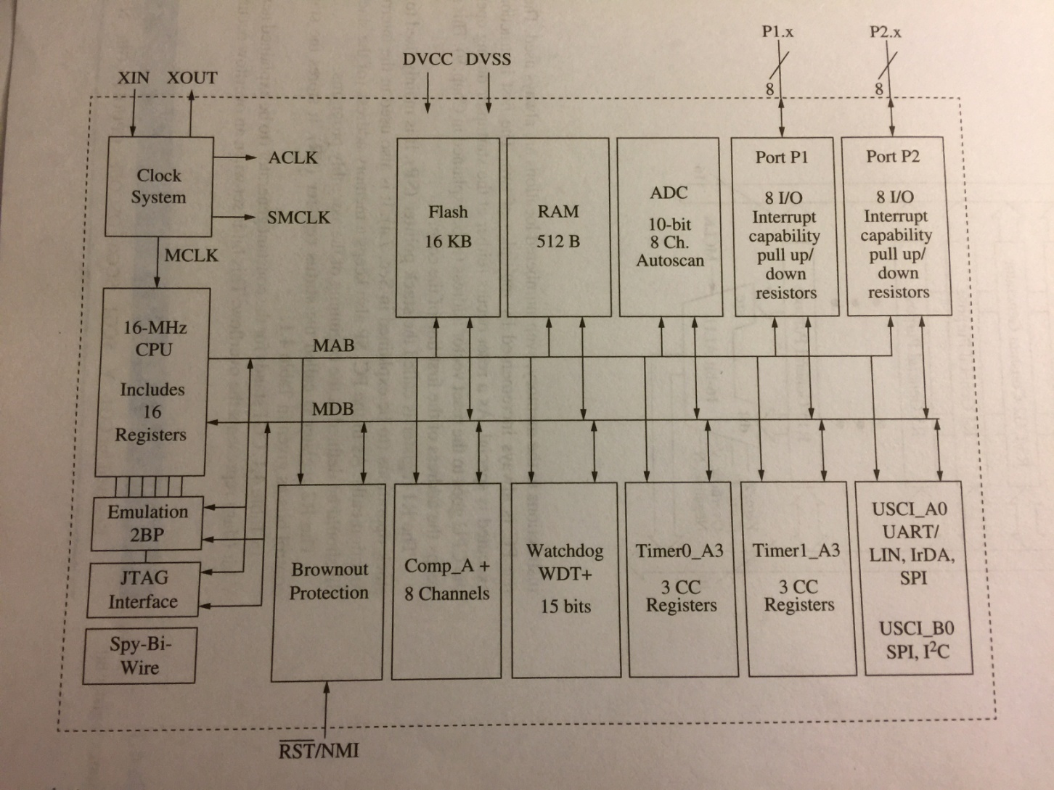
MSP430 Overview

Slide 5
CPU
ALU
4 regristers
Program Counter
Stack Pointer
Status Register
Constant Number Generator
RISC (Reduced Instruction Set Computing)
27 Imbeded Instructions
24 Emmulated Instructions

Slide 6
The Board
5 Volt regulator, with N4004 diode protection Mr. Perry insists we use, because he hardware shames us if we do not.
Push buttons for input.
ULN2003 IC for the motor driver.
Capacitors for reducing signal bouncing.

Slide 7
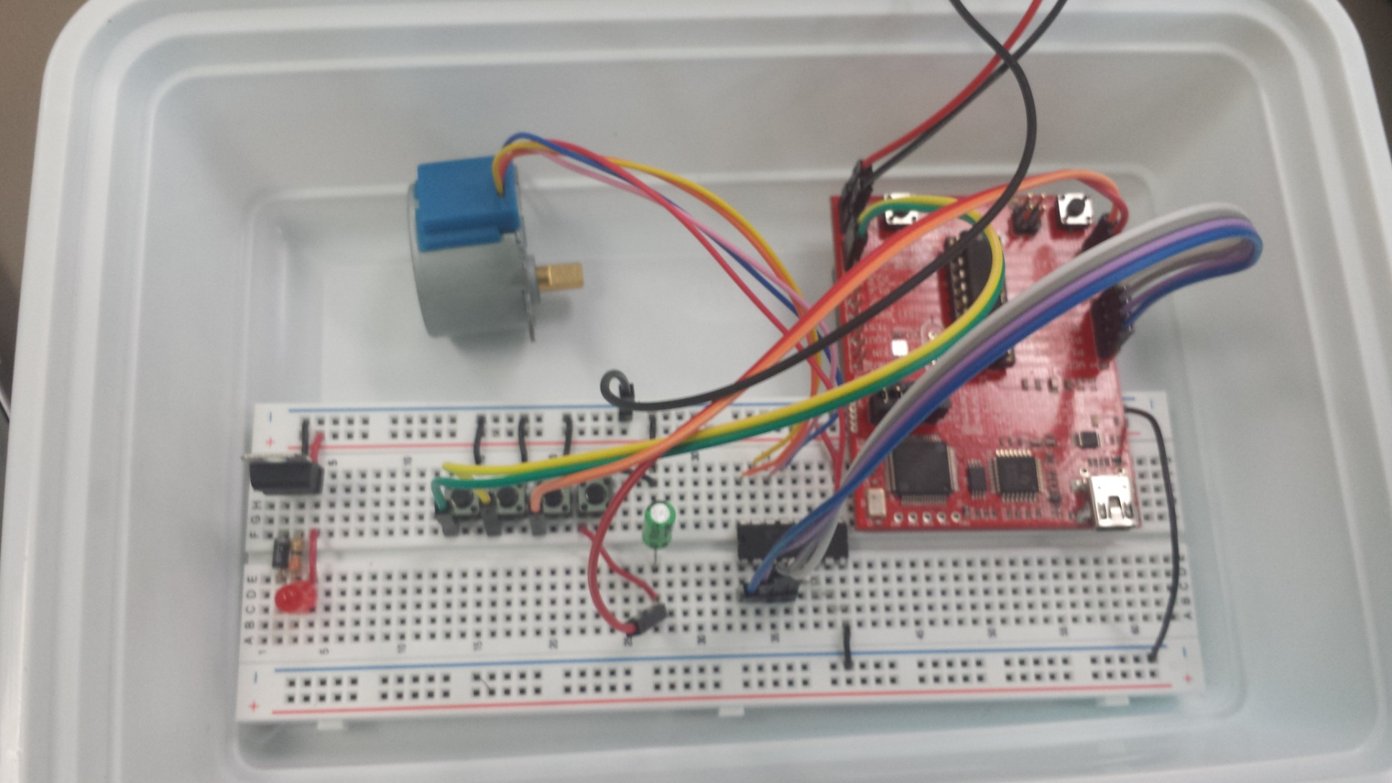
The Assembled Board

Slide 8
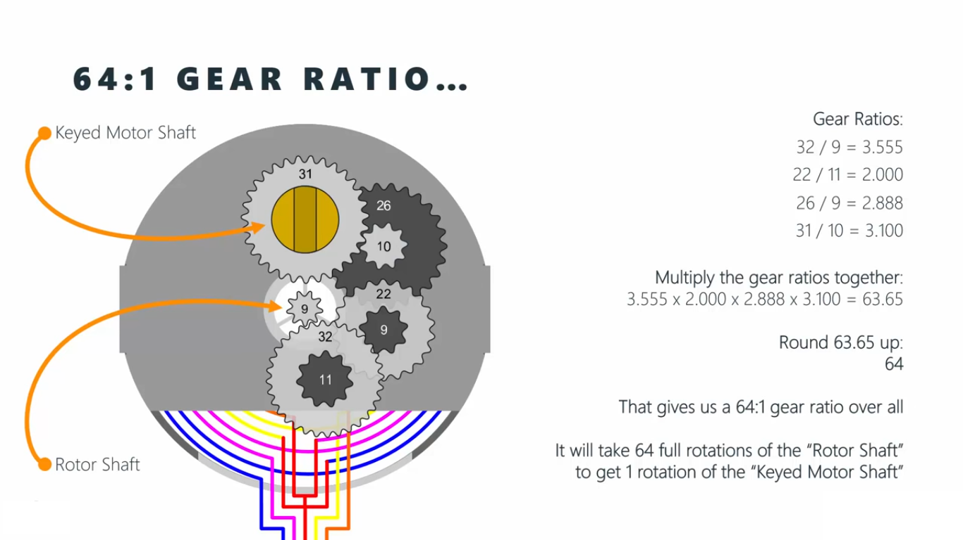
Gear Ratio for the Stepper Motor

Slide 9
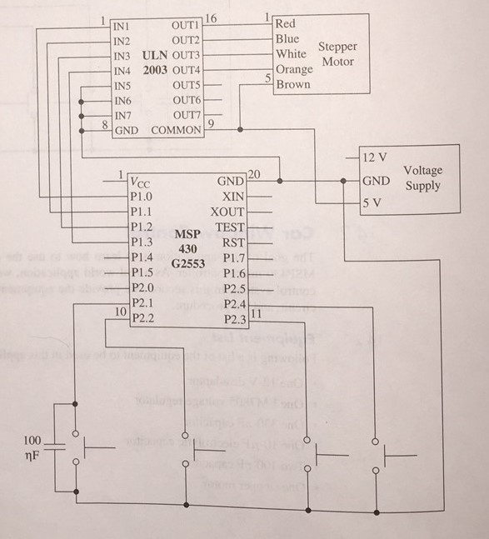
The schematic for Window Control System
Parts List:
1 - 12 V DC Battery
1 - 12 V DC Battery connector
1 - N4004 Diode for the voltage regulator (Not on schematic)
1 - 330 ohm resistor for the voltage regulator (Not on schematic)
1 - LM7805 voltage regulator
1 - 330-nf capacitor
1 - 10 - uf electrolytic capacitor
2 - 100 - nf capacitors
1 - Stepper motor
1 - ULN2033 motor driver
4 - Push buttons
1 - Bread board (Not on schematic)
1 - MSP430 Micro Controller (Not on Schematic)

Slide 10
The Software
Initialization
Define the terms for to make the coding easier
On, Off, Clockwise, Counter Clockwise

Slide 12
Initialization
Port 1 initialization
Port 2 initialization
Spin function
Timer
Interrupt function

Slide 13
Main Function
Main Function
Set timers.
Initialize the interrupts for output motor.
Port 1
Initialize the interrupts for input buttons.
Port 2
Checks for child safety.
Checks bit 4 if set not movement occurs.
Begins spin function.

Slide 14
Spin Function
Initializes the constant variables for the output to the stepper motor
While loop for power on.
Full Rotation -

Slide 15
Implementation

Slide 16
Conclusion
Very satisfying to see theory put into practical applications.
Working together in a team taught us to divide and conquer.
It would be nice to have more time and a harder problem to tackle.

